Slide 1
Final Project – MRI Segmentation 336016 – Deep Learning Applications in MRI Spring 2020
Tom Ron
Sapir Gershov

Slide 2
Project Goal
Segmentation of gliomas (tumors) in brain MRI
Using BraTS18 dataset
Compare to leaderboard results from past BraTS challenges
Exploring modifications of the basic UNet
Different encoders
UNet, Resnet34/50
Transfer learning from non-medical domain (pretrained encoder on ImageNet)
Squeeze-and-Excitation (Self Attention)

Slide 3
Dataset
BraTS 2018 – Brain tumor segmentation challenge
Comes with 4 Modalities (T1, T1Gd, T2, FLAIR)
HGG and LGG tumors (High-grade and low-grade gliomas)
Total of 285 scans (~19000 annotated slices)
60-20-20 train-validation-test split (by patient)
Notes:
Splitting by patient is important!
At first we didn’t do so and we noticed very high dice scores on the test set
We then realized that this is a form of data leakage – two adjacent slides from the same scan (which are very very correlated) can go to either train/validation sets

Slide 4
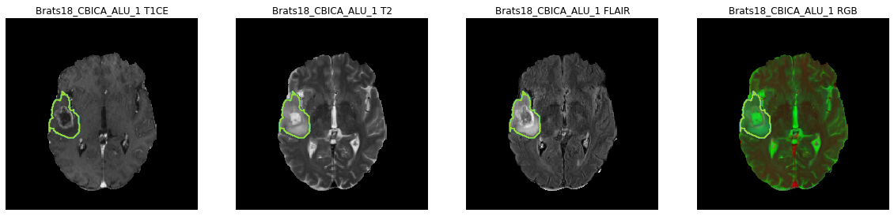
Dataset
Simplifications made:
Took only T1Gd, T2 and FLAIR modalities (3 channels)
Merged 4 segmentation masks to a single binary mask (“Whole Tumor” label)
Feeding 2D slices instead of 3D volumes

Slide 5
Chosen Method(s)

Slide 6
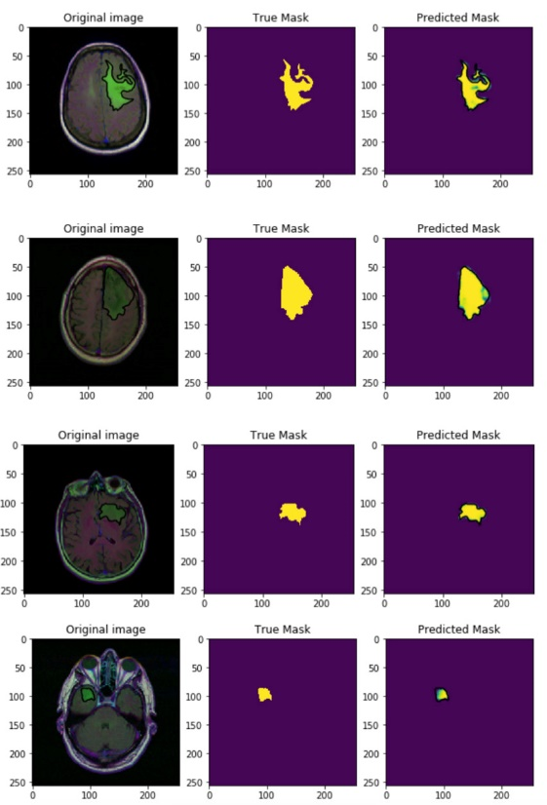
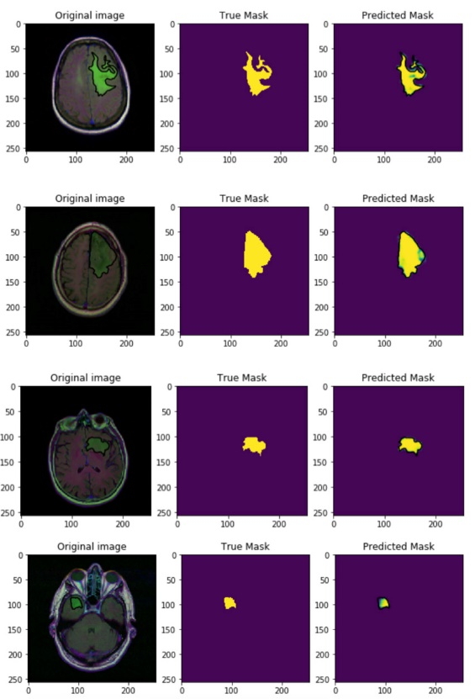
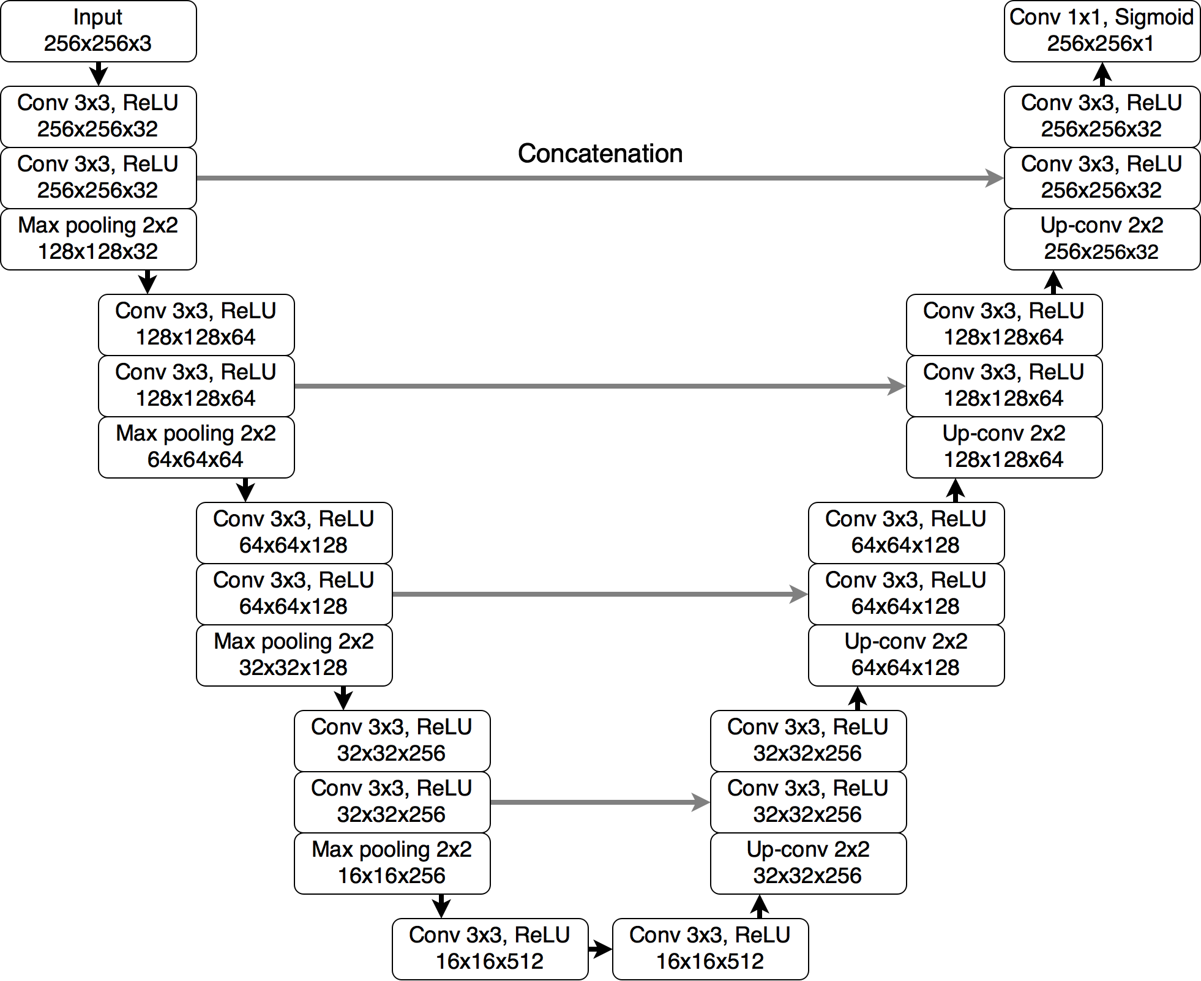
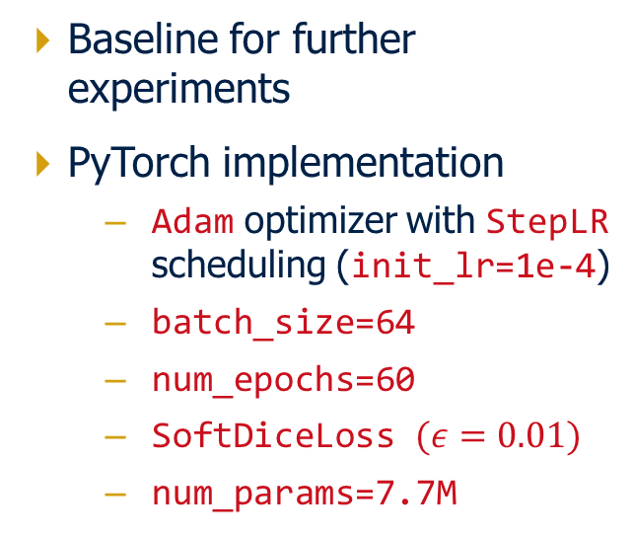
Method #1 – Basic UNet
Baseline for further experiments
PyTorch implementation
Adam optimizer with StepLR scheduling (init_lr=1e-4)
batch_size=64
num_epochs=60
SoftDiceLoss $(ε=0.01)$
num_params=7.7M

Slide 7
Method #1 – Basic UNet – Results
Notes:
I.e, the winner of BraTs18 (unet with autoencoder regularization) obtained dice score of ~ 0.91
It was on a different dataset (brats validation dataset) so it is not completely comparable but gives a sense of where we are

Slide 8
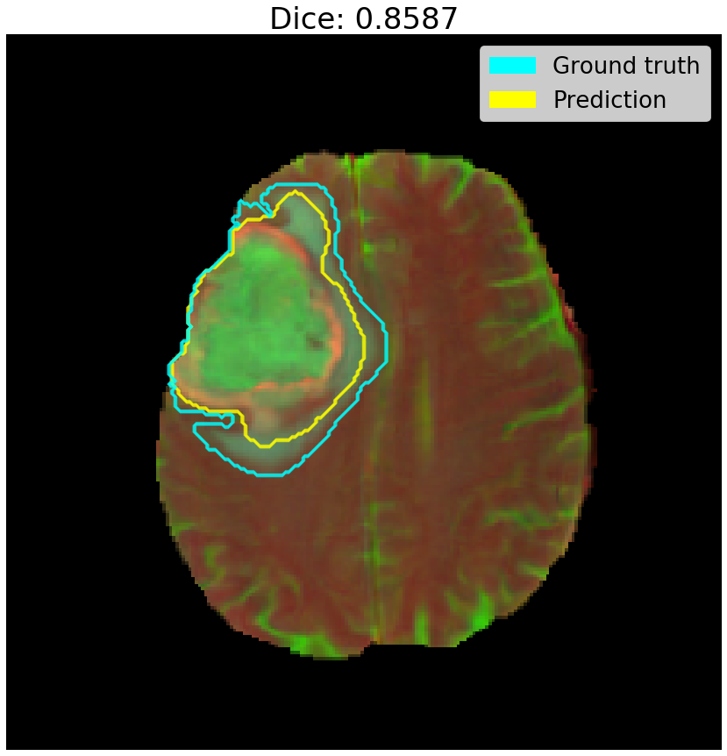
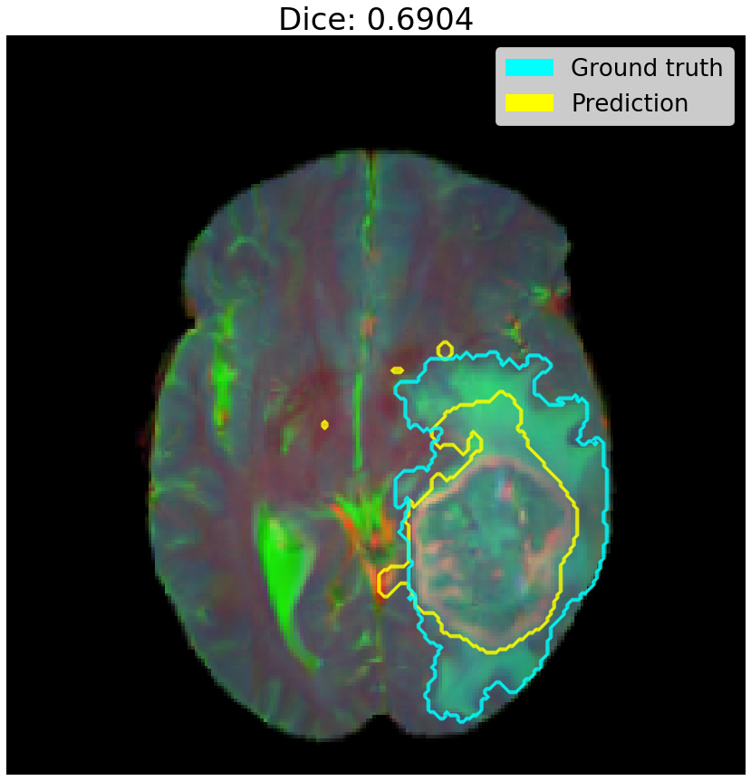
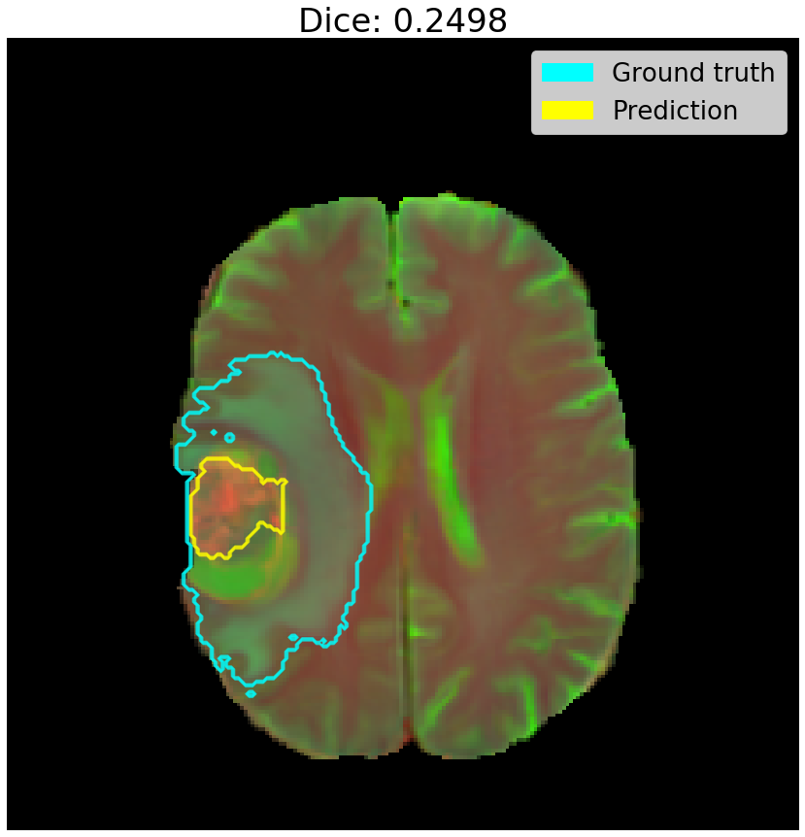
Method #1 – Basic UNet – Results
Notes:
I.e, the winner of BraTs18 (unet with autoencoder regularization) obtained dice score of ~ 0.91
It was on a different dataset (brats validation dataset) so it is not completely comparable but gives a sense of where we are

Slide 9
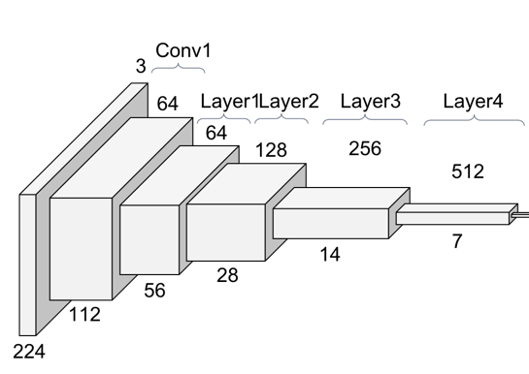
Method #2 – UNet with ResNet encoder
Replaced the encoder part of the basic UNet
Decoder stays the same
Encoder-Decoder skip connections before every Maxpool operation
Different backbones:
ResNet34 (24.5M params)
ResNet50 (32.5M params)
Same hyperparameters as method #1
Adam optimizer, LR scheduling, batch size etc.
ResNet34 Encoder

Slide 10
Method #2 – UNet with ResNet encoder – Results
Notes:
ResNet50 performs even poorly than basic UNet

Slide 11
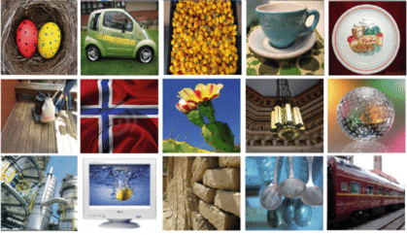

Method #3 – UNet with ResNet pretrained encoder
Using pretrained ResNet encoders on ImageNet
Transfer learning from non-medical domain
Same hyperparameters as method #2
ResNet34 Encoder

Slide 12
Method #3 – UNet with ResNet pretrained encoder – Results

Slide 13

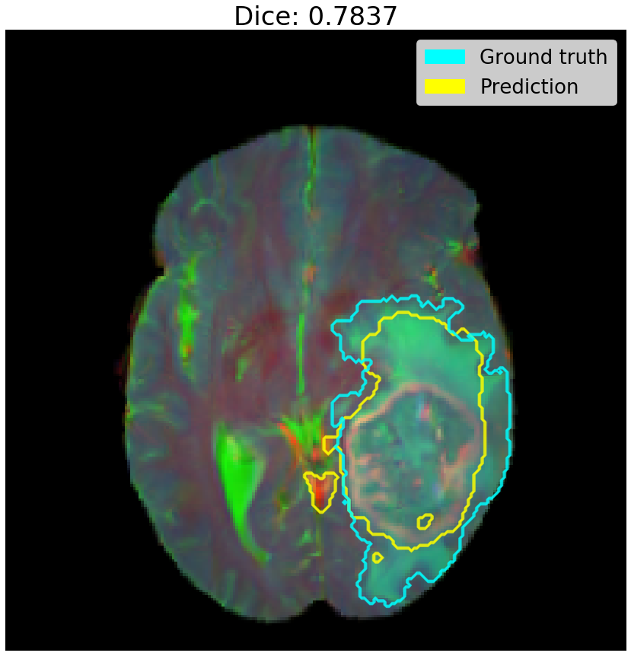

Method #3 – UNet with ResNet pretrained encoder– Results ResNet34 pretrained encoder

Slide 14
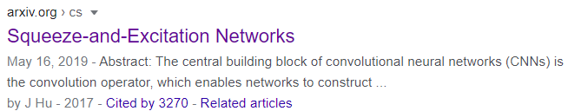
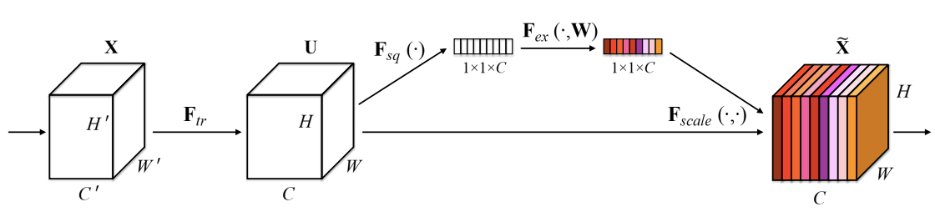
Method #4 – Squeeze-and-Excitation (SE)
Introduced by Hu et. al, ‎2017
Adds a learnable scalar to every convolution filter
Weighs filters in relation to others
Can be thought of as a form of “self attention”
Easily implemented and can be added to existing architectures
Consistent improvement w.r. to the SOTA (at least back in the day…)

Slide 15
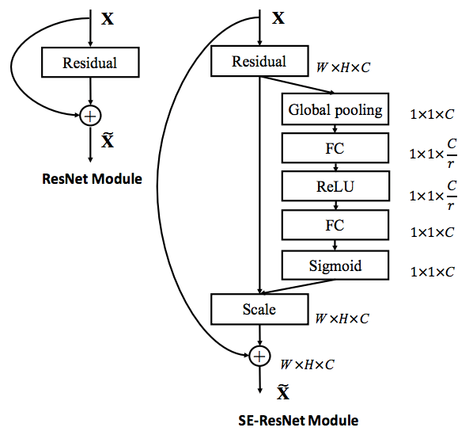
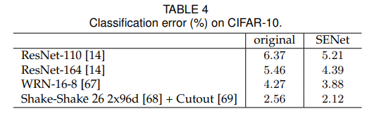
Method #4 – Squeeze-and-Excitation (SE)

Slide 16
Method #4 – Squeeze-and-Excitation (SE) – Results

Slide 17

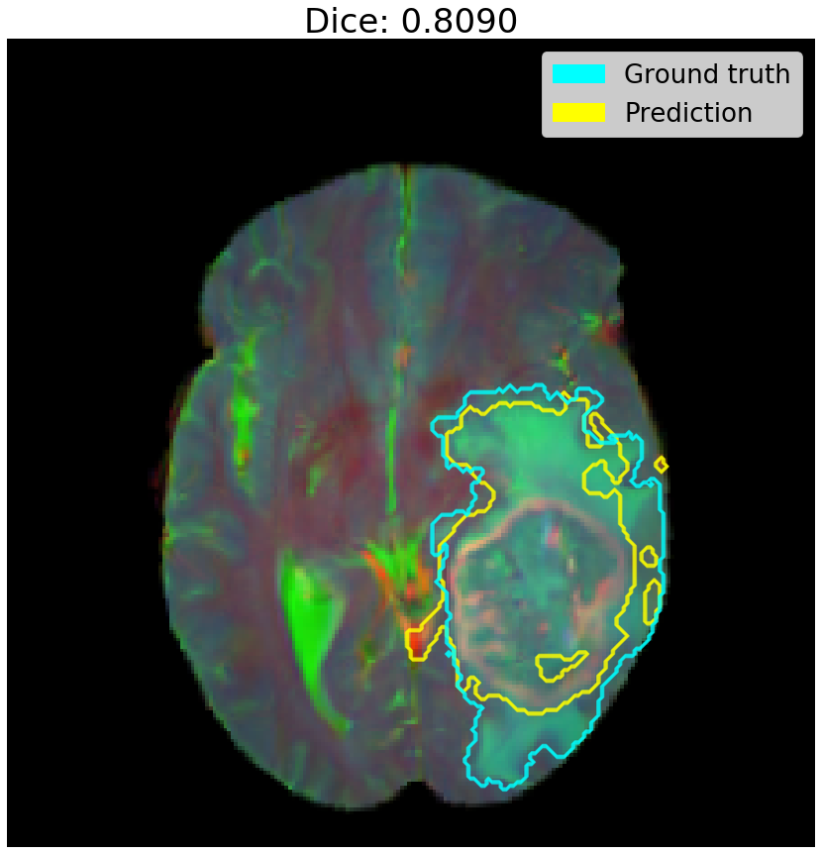

Method #4 – Squeeze-and-Excitation (SE) – Results ResNet50 pretrained encoder with SE blocks

Slide 18


Results Summary
Test Dice | Val Dice | SE | Pretrained | # Params | Architecture | #
0.8736 | 0.8637 |  |  | 7.7M | Basic UNet | 1
0.8767 | 0.8612 |  |  | 24.4M | UNet with ResNet34 Encoder | 2
0.8834 | 0.8739 |  |  | 24.4M | UNet with ResNet34 Encoder | 3
0.8721 | 0.8619 |  |  | 24.5M | UNet with ResNet34 Encoder | 4
0.8744 | 0.8782 |  |  | 24.5M | UNet with ResNet34 Encoder | 5
0.8627 | 0.8553 |  |  | 32.5M | UNet with ResNet50 Encoder | 6
0.8877 | 0.8795 |  |  | 32.5M | UNet with ResNet50 Encoder | 7
0.8734 | 0.8556 |  |  | 33.8M | UNet with ResNet50 Encoder | 8
0.8889 | 0.8763 |  |  | 33.8M | UNet with ResNet50 Encoder | 9

Slide 19
Conclusions
Results probably lack statistical significance
Requires CV
The “basic” UNet is not bad
Can be improved
Pretraining on ImageNet helps
Especially when the NN goes deeper
Squeeze-and-Excitation block don’t have a clear effect
Requires further experiments
It was fun

Slide 20
Thanks

